Slide 1
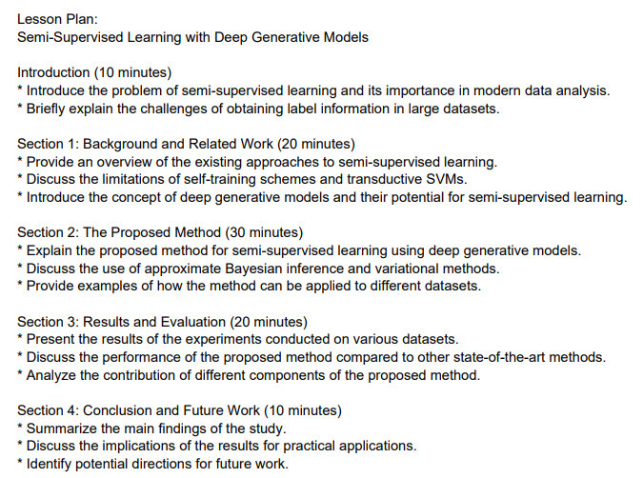
Multimedia Gen AI-Powered Course Module Generator
Eddie McGowan & Alex Kash
Lehigh University
Abstract
Data & Data Pipeline
This project presents an AI system that transforms teacher-provided resources—like PDFs, articles, and web links—into structured, engaging lesson plans. Unlike commercial tools, it gives educators full control over inputs and output formats.
Key Features:
Accepts multimedia inputs (text, images, tables)
Editable prompt interface for teachers
“Reprompt”/“Approve” workflow for refining lessons
Automatic website deployment for student access
By supporting diverse inputs and publishing lessons directly to the web, this tool saves time, boosts personalization, and enhances instructional quality—all while keeping teachers in control.
No fixed dataset; uses teacher-uploaded materials (PDFs, articles, web links, tables) at runtime.
Processes inputs in real time to create personalized, structured lessons (see Pipeline below).
Adapts to different teaching styles without requiring extra model training.
INPUTS
PROCESSING
OUTPUT
LLAVA Pretrained Context
Overall
PDF and Web Documents (Lesson Plans, Resources)
Text, Image, Table, Extraction and Preprocessing
LLAVA Model Creates Lesson Plan
Lesson is Saved in a JSON Format
Lesson Plan is Published on Website using Flask
Initial Prompt by Teacher
Teacher can re-prompt model to adjust lesson plan content
FEEDBACK
LOOP
Problem Description & Motivation
INPUTS
Extract Text Content using PyMuPDF
PROCESSING
OUTPUT TO MODEL
Lesson planning is time-consuming, especially when customizing for goals or student needs.
Commercial AI tools often limit input control and personalization.
Educators need a flexible solution to create modules from their own resources.
This project builds a tool to empower teacher-driven content generation.
PDF Content Provided by Teacher
Extract Table Content Using PDFPulmber
Convert each table to markdown format for tokenization
Content
Extraction
Extract Image Content Using PDFPulmber & Pillow
Combined Document Context
Web Content Provided by Teacher
Extract Text & Image Content Using BeautifulSoup
Extract Table Content Using BeautifulSoup
Convert each table to markdown format for tokenization
Model Selection
Tools Utilized:
Resource Input: PDFs, articles, and web links
Extraction Tools: PyMuPDF (text), PDFPlumber & Pillow (images/tables), BeautifulSoup (web scraping)
Model Backend: Llama-2-7b-chat-hf (multimodal LLM)
Frontend: Streamlit interface for lesson generation hosted on lehigh magic-02 high performance computer
Models Tested
Comparison With Existing Tools
Sample Workflow
Teacher uploads a PDF and edits a default lesson prompt.
AI extracts text, tables, and images.
Lesson is generated and previewed.
Teacher selects “Reprompt” or “Approve.”
Final version is deployed to the class website.
Evaluation
Model | Inputs | Notes
Llama-2-7b-chat-hf (Chosen Model) ✅ | Text, Tables | Excels at summarizing text; does not accept images
LLaVA 1.5 ❌ | Images, Text, Tables | Poor at summarizing text
LLaVA 1.6 ❌ | Images, Text, Tables | Cannot be configured on Magic-02
OpenAI GPT-4o ❌ | Images, Text, Tables | Requires paid subscription for unlimited access
A sample lesson plan output from the Model.
Conclusion
This tool empowers educators with a fast, flexible lesson planning workflow. It supports multimodal materials and reduces iteration cycles by incorporating teacher feedback in real-time. Students benefit from more personalized and engaging learning modules.
Future World:
Link with educational platform (e.g., Lehigh Course Site)
Deploy on cloud infrastructure for scalability
Change the backend model to LLaVA 1.6 to support image inputs
Accept video inputs
Preload state and national educational requirements to ensure lesson plans meet educational benchmarks
Feature | This Project | Khanmigo (Khan Academy)
Teacher Defined Sources | ✅ | ❌
Media Extraction (PDF/Web) | ✅ | ❌
Web Publishing | ✅ | ❌
Feedback-based revision | ✅ | ❌
Acknowledgements
Masoud Yari
Todd George

